Slide 1
Banking in a COVID Environment
8 May 2020

Slide 2
Contents
Introduction
COVID 19 Cyber Crime :- Facts & Stats
COVID19 Common Cyber Attack Methods
Safety Checklist
Cyber Security in BOA-Ghana

Slide 3
Introduction
Whiles there are some remarkable feats to be celebrated by most companies adopting new dynamics of doing business in this COVID19 times, there are equally increase in ‘success’ also being enjoyed by the criminals exploiting the various vulnerabilities that come with the new dynamics of work.
Teleworking Tools :-Remote working helps Zoom grow 169% in one year, posting $328.3M in revenue Q1 2020
Streaming services :- Netflix adds 16 million subscribers in the first quarter more than a double growth than predicted in January
Online Retails :- Amazon goes up 25%
Telecommunication:- MTN saw an uptick in data subscribers grew by 5.5% whiles Momo users grew to 15.5 million, a 6.9% increase.
References: Techcrunch, CBS New York, and Connecting Africa

Slide 4
Cyber Crime facts and Stats
Apple, Netflix, and Yahoo Account for 25% of Brand Impersonations in Phishing Attacks in Q1 2020
FBI report indicate 3000-4000 daily complaints through their internet portal from a 1000 daily complaints pre COVID
A ransomware attack in early 2020 on the New Orleans city government cost the city upwards of $7 million
South Africa’s Post-Bank is replacing 12 million Bank cards after major security breach.
Travelex paid $2.3M of $6M demanded by ransomware operators
$10M stolen from Norway’s state investment fund in a business email compromise.
References: CSIS, infosecurity-magazine, Bankinfosecurity

Slide 5
COVID 19 Common Cyber Attack Methods
Malicious domains
Malware
Ransomware

Slide 6
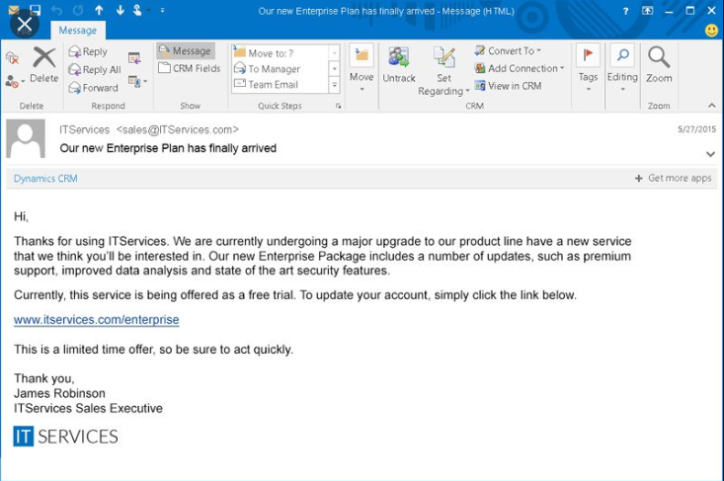
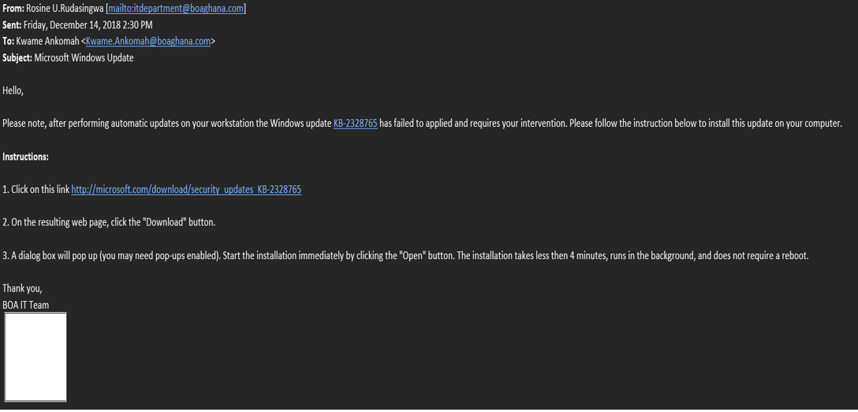
COVID 19 Common Cyber Attack Methods

Slide 7
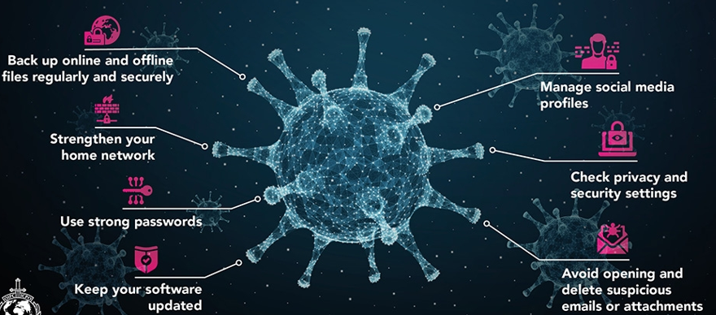
Safety Checklist

Slide 8
Cyber Security in BOA-Ghana
BOA-Ghana is certified in ISO 27001 in Information Security Management Systems and ISO 22301 in Business Continuity Management System, which means we adhere to all 114 controls required by the International Organization of Standards.

Slide 9
Cyber Security of BOA Digital Platforms
Internet banking BOAweb:
Equipped with multi factor authentication using Google authenticator.
Implores the use of virtual keyboard to prevent any form of key logging activities during their sign-ins.
Session timeouts
Runs on Https
BMobile:
Biometrics or password to access the platform

Slide 10
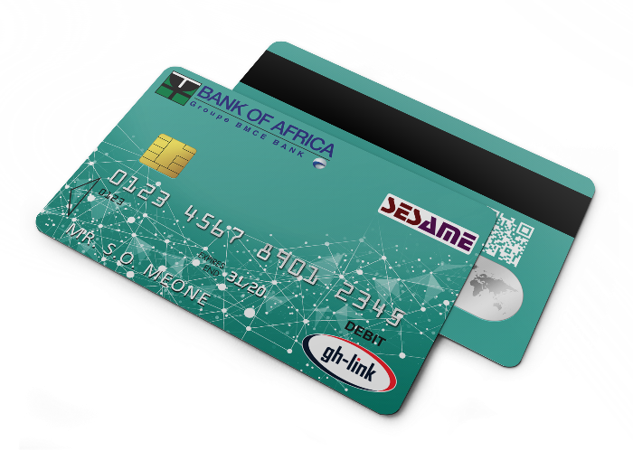
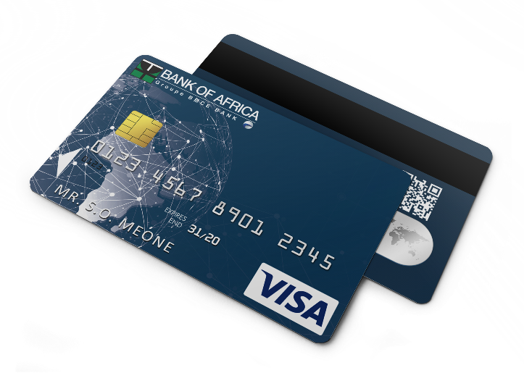
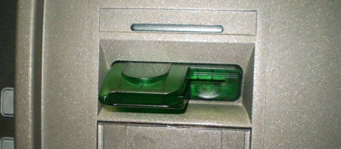
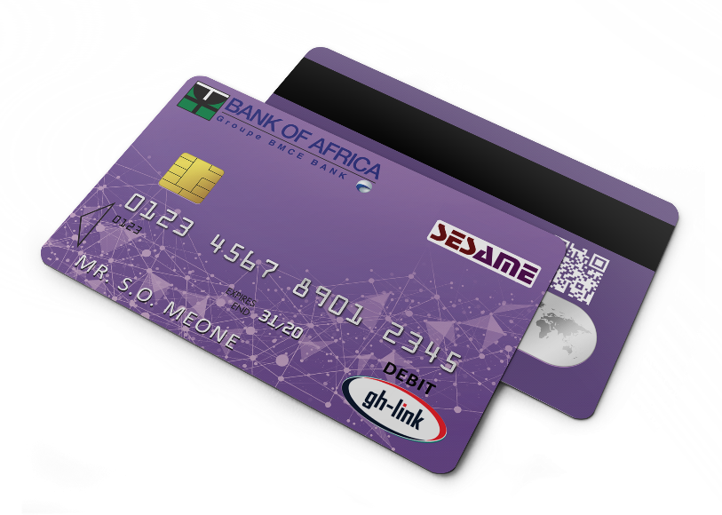
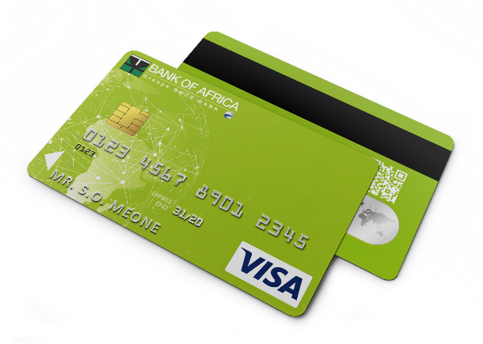
Cyber Security of BOA Digital Platforms
ATM:
Anti-Skimming
Cards are chip and pin enabled, providing secure transaction for the customer.

Slide 11
Q&A

Slide 12
THANK YOU

